Slide 1
Early Foundations (1950s-1960s)
Binary Brains: Ambalika Rajendran, Favour Asu, Joseph Hiller, Misty Richardson, Zaid Tahir Jamil

Slide 2
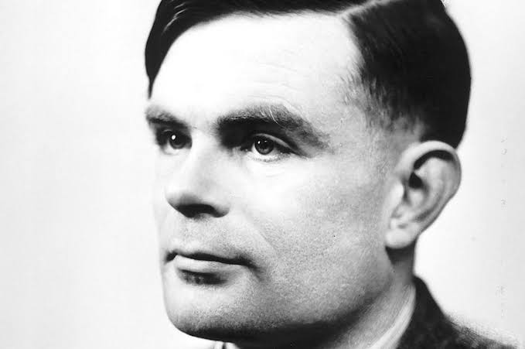
Alan Turing
Alan Turing (1912–1954) was a British mathematician, logician, and computer scientist who made significant contributions to several fields, particularly in the early development of computer science and artificial intelligence.
He formulated the concept of the computer while tackling the challenging Entscheidungsproblem.
He played a crucial role in breaking the Enigma code, a significant achievement during World War II that is estimated to have shortened the war and saved lives. The development of the bombe, a machine capable of decoding Enigma-encrypted messages, showcased Turing's practical contributions.

Slide 3
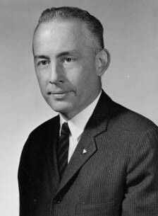
Nathan Rochester (1919 – 2001)
Nathan Rochester was an American mathematician and computer scientist who was the chief artitect of the IBM 701
Rochester, along with his colleagues at IBM, played a crucial role in the creation of the Logic Theorist, one of the earliest AI programs.
The Logic Theorist marked a foundational step towards the advancement of computer vision and pattern recognition technologies.

Slide 4
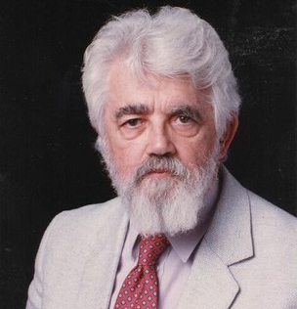
John McCarthy (1927 – 2011)
John McCarthy was an American computer scientist and cognitive scientist who played a pivotal role in the development of artificial intelligence (AI).
McCarthy is best known for coining the term "artificial intelligence" and for his foundational work in the field.
While McCarthy's contributions were not specifically focused on computer vision, his overarching influence in AI laid the groundwork for advancements in various subfields, including computer vision.

Slide 5
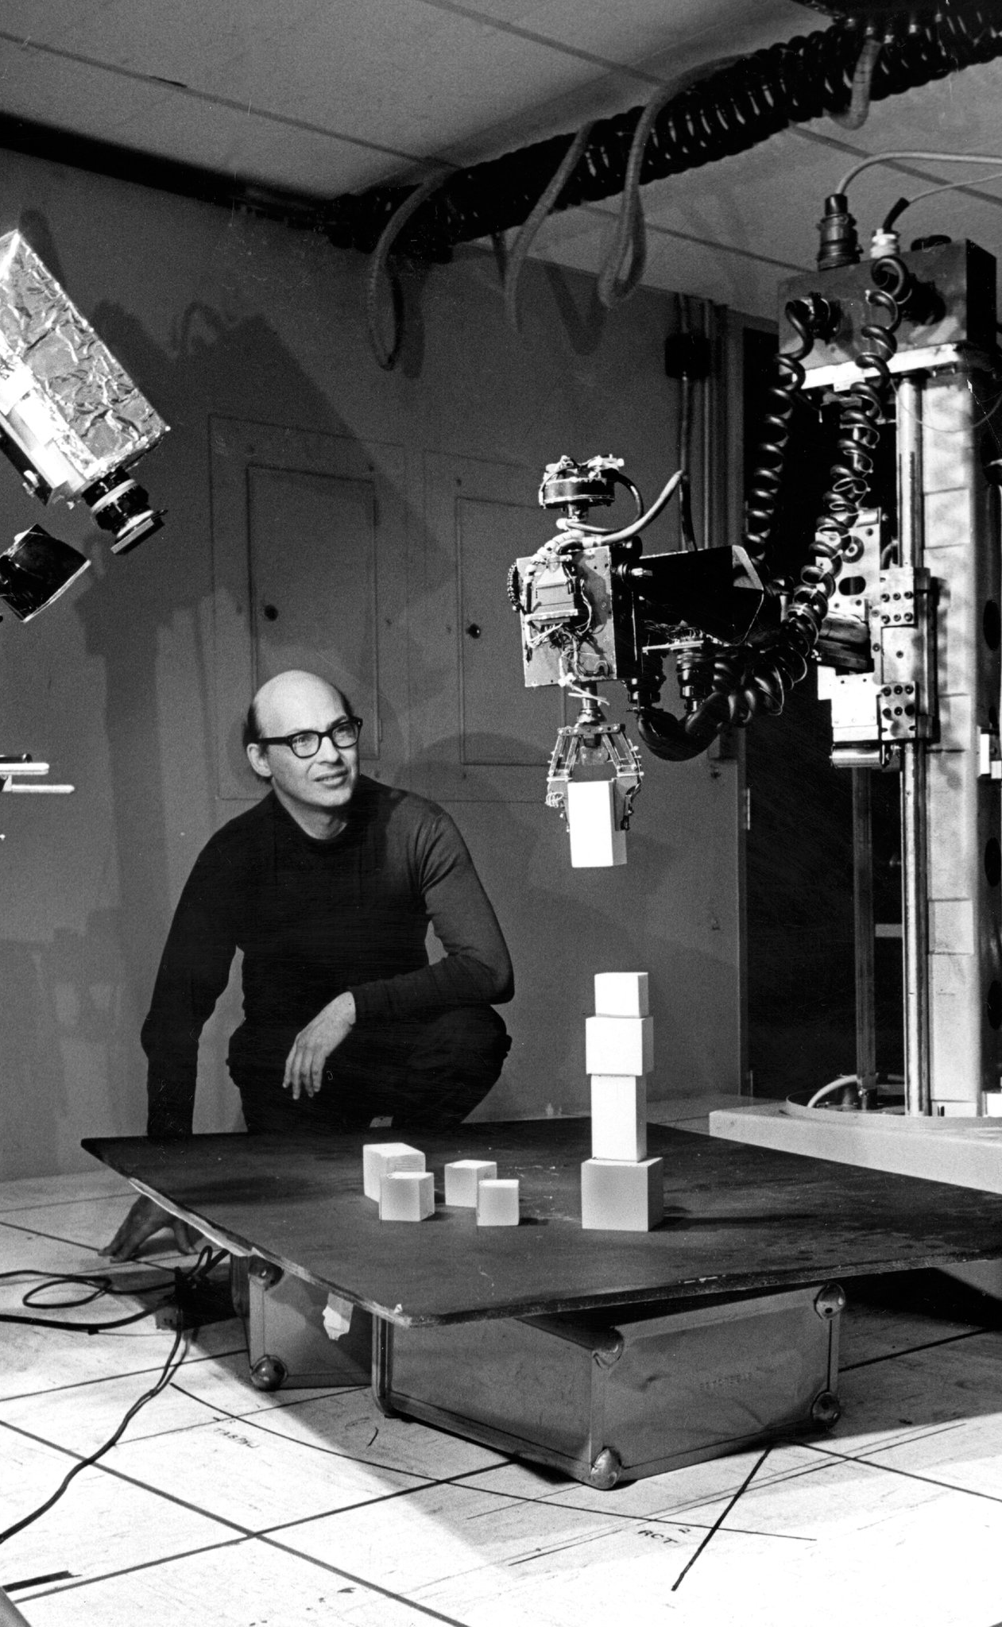
Marvin Minsky 1951 - 2016
Background:
American mathematician and computer scientist
One of the most famous practitioners of the science of artificial intelligence (AI)
Winner of the 1969 Turing Award
Contributions:
Built the first neural network simulator in 1951 (SNARC)
Invented the confocal scanning microscope in 1959. The scanning of the illumination point in the focal plane was achieved by moving the stage.
Co-founded the Artificial Intelligence Project (now the MIT Computer Science and Artificial Intelligence Laboratory) in 1959
Developed pattern recognition algorithms that allowed computers to identify and classify visual patterns in images
Designed and built some of the first visual scanners

Slide 6
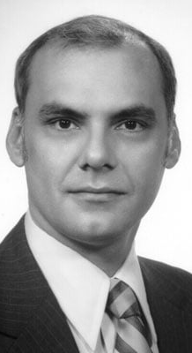
Lawrence Roberts 1965 - 2018
Background:
American engineer who supervised the construction of the Advanced Research Projects Agency Network (ARPANET)
Received the Draper Prize in 2001 “for the development of the Internet”
Known as the "father of Computer Vision"
Contributions:
His Ph.D. thesis, 'Machine Perception of Three-Dimensional Solids,' was in the field of computer vision, and he is often referred to as the true founder of image recognition or computer vision applications
Discussed the possibilities of extracting 3D geometrical information from 2D perspective views of blocks (polyhedra) in his Ph.D. thesis at MIT

Slide 7

Key Advancements
During the 1950s and 1960s, the groundwork for computer vision was laid through several key advancements:
Neural Network Research: Marvin Minsky and Dean Edmonds developed the Stochastic Neural Analog Reinforcement Calculator (SNARC) in 1951, an early attempt at simulating neural networks for pattern recognition.
Perceptron: Frank Rosenblatt introduced the perceptron in 1957, a computational model inspired by the human neuron. This marked a significant advancement in machine learning and pattern recognition, demonstrating the potential for machines to learn and recognize patterns.
Pandemonium Model: Oliver Selfridge proposed the "Pandemonium" model in 1959, a hierarchical pattern recognition system. It introduced the concept of layered processing, influencing future approaches to image analysis and feature extraction.
Face Recognition: In 1960, Patrick Winston developed the "Terry" face recognition system, showcasing the potential for automated image analysis and object recognition.
Summer Vision Project: Lawrence Roberts led the Summer Vision Project in 1966, a collaborative effort that accelerated advancements in image processing techniques and computer vision algorithms.
Vision as AI Problem: John McCarthy and Ed Fredkin's 1968 paper emphasized the interdisciplinary nature of computer vision and its connections to artificial intelligence, cognitive science, and mathematics.
These advancements set the stage for further research and development in computer vision, laying the foundation for the field's future growth and innovation.

Slide 8
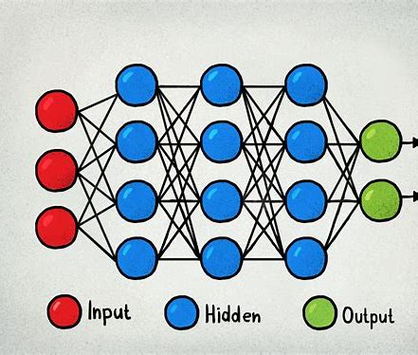
Neural Network Research
Neural networks, also known as artificial neural networks (ANNs) or simulated neural networks (SNNs), are a subset of machine learning and are at the heart of deep learning algorithms. Their name and structure are inspired by the human brain, mimicking the way that biological neurons signal to one another.

Slide 9
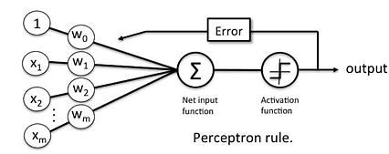
Perceptron
Perceptron is one of the simplest Artificial neural network architecture. It was introduced by Frank Rosenblatt in 1957s. It is the simplest type of feedforward neural network, consisting of a single layer of input nodes that are fully connected to a layer of output nodes. It can learn the linearly separable patterns. it uses slightly different types of artificial neurons known as threshold logic units (TLU). it was first introduced by McCulloch and Walter Pitts in the 1940s.
Types of Perceptron
Single-Layer Perceptron: This type of perceptron is limited to learning linearly separable patterns. effective for tasks where the data can be divided into distinct categories through a straight line.
Multilayer Perceptron: Multilayer perceptrons possess enhanced processing capabilities as they consist of two or more layers, adept at handling more complex patterns and relationships within the data.

Slide 10
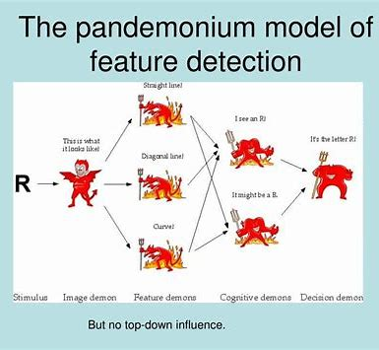
Pandemonium Model
Pandemonium architecture is a theory in cognitive science that describes how visual images are processed by the brain. It has applications in artificial intelligence and pattern recognition. The theory was developed by the artificial intelligence pioneer Oliver Selfridge in 1959. It describes the process of object recognition as a hierarchical system of detection and association by a metaphorical set of "demons" sending signals to each other. This model is now recognized as the basis of visual perception in cognitive science.

Slide 11
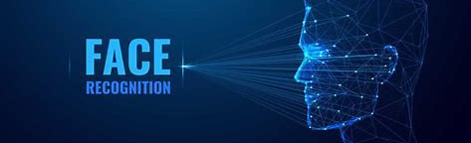
Face Recognition
Face recognition is a type of computer vision that uses optical input to analyze an image—in this case, it looks particularly at faces that appear in the image. Facial recognition technology can be used as a building block to support other capabilities like face identification, grouping, and verification

Slide 12

Summer vision project
Lawrence Roberts led the Summer Vision Project in 1966, a collaborative effort that accelerated advancements in image processing techniques and computer vision algorithms.

Slide 13
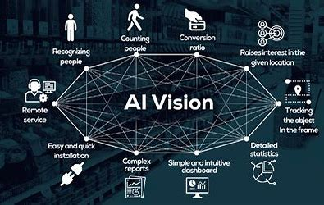
Vision as AI Problem
Vision AI (also known as Computer Vision) is a field of computer science that trains computers to replicate the human vision system. This enables digital devices (like face detectors, QR Code Scanners) to identify and process objects in images and videos, just like humans do.
Personalized image search on eCommerce stores, 3D model building (Photogrammetry), aeriel images on a map, OCR scanning in retail outlets, face recognition, image detectors, MRI reconstruction are some of the innovative use cases of computer vision that we have today.

Slide 14
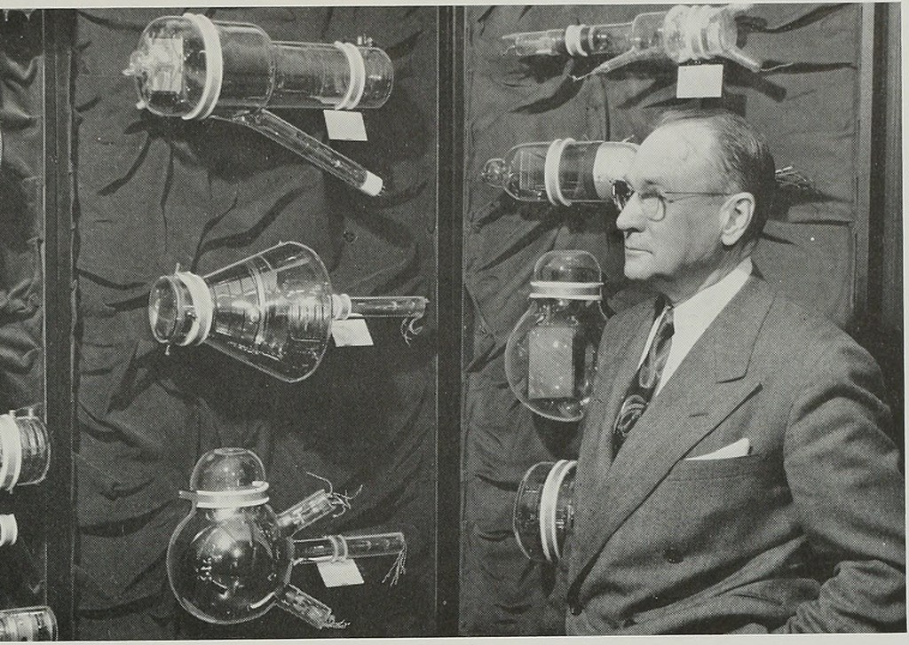
Impactful applications: 1950- Vidicon Tube
RCA and P. K. Weimer, S. V. Forgue and R. R. Goodrich introduce Vidicon tube, a video camera tube design in which the target material is a photoconductor. Prior to the late 1970s, NASA used Vidicon cameras on most of their unmanned deep space probes equipped with the remote sensing ability.

Slide 15
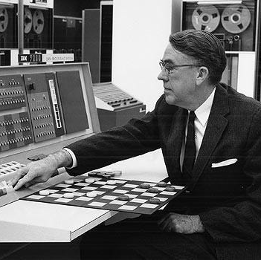
Impactful applications: 1951- 1st AI program
The 1st ever AI program ever written was a checkers playing program.
The program was written by Arthur Samuel.

Slide 16
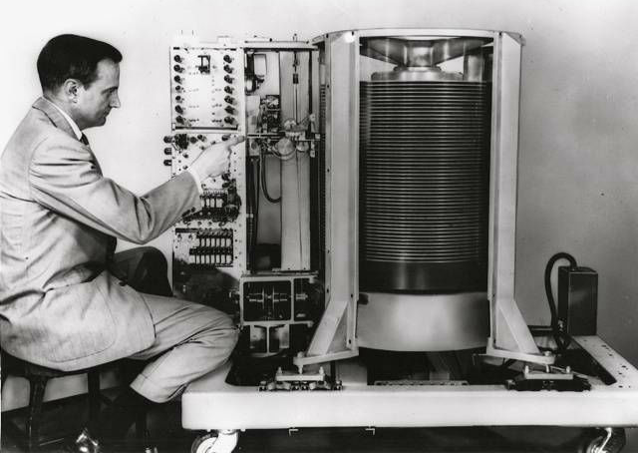
Impactful applications: 1953- 1st hard drive
In 1956 IBM introduced their 1st magnetic data-storage systems but it was actually invented in 1953

Slide 17
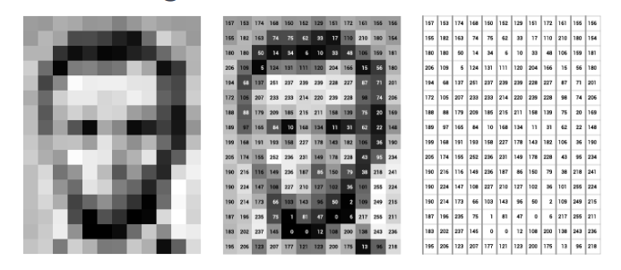
Impactful applications: 1959- 1st digital scanner
The first digital image scanner was invented by transforming images into grids of numbers.

Slide 18
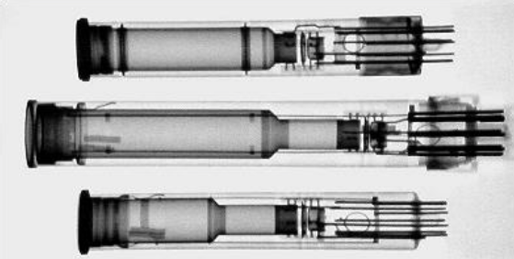
Impactful applications: 1960- Plumbicon
To offer more image stability Philips introduces the Plumbicon.
Plumbicons were used in x-rays, tv's, and cameras

Slide 19
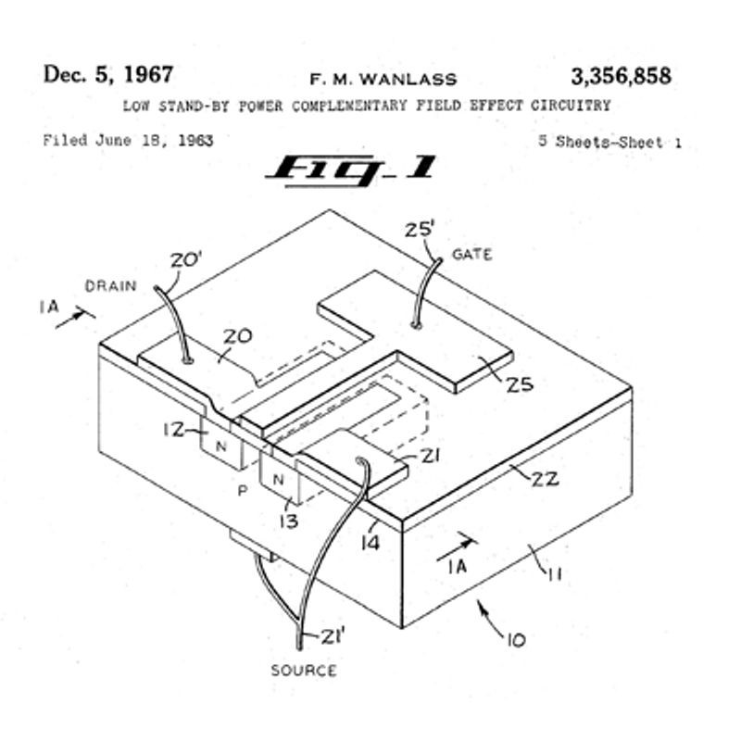
Impactful applications: 1963- CMOS invented
Frank Wanlass, American electrical engineer patents CMOS (complementary metal-oxide-semiconductor) logic circuits used in digital logic circuits as well as analog circuits like CMOS image sensors.

Slide 20
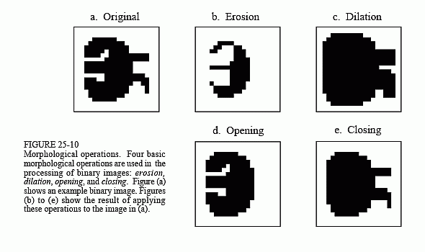
Impactful Applications: 1964
Morphological Image Processing​

Slide 21
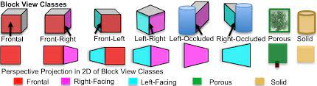
Block World & Early Shape Representation
The concept of "Block World" and early shape representation in the field of computer vision was introduced by Lawrence G. Roberts in the 1960s.
The Block World model aimed to represent objects in a scene using simple geometric shapes, providing a foundational approach to early attempts at computer-based vision and object recognition.

Slide 22
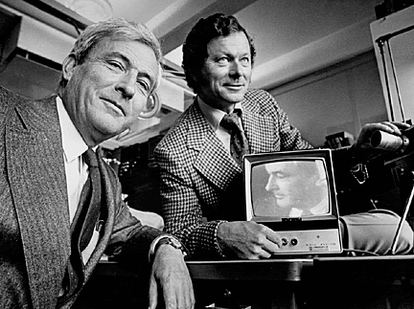
Impactful applications: 1969- CCD invented
CCD, or charged-couple device is invented at American Bell Laboratories by William Boyle and George E. Smith, allowing for the transfer of a charge along the surface of a semiconductor from one storage capacitor to the next - a major contribution to digital imaging.

Slide 23
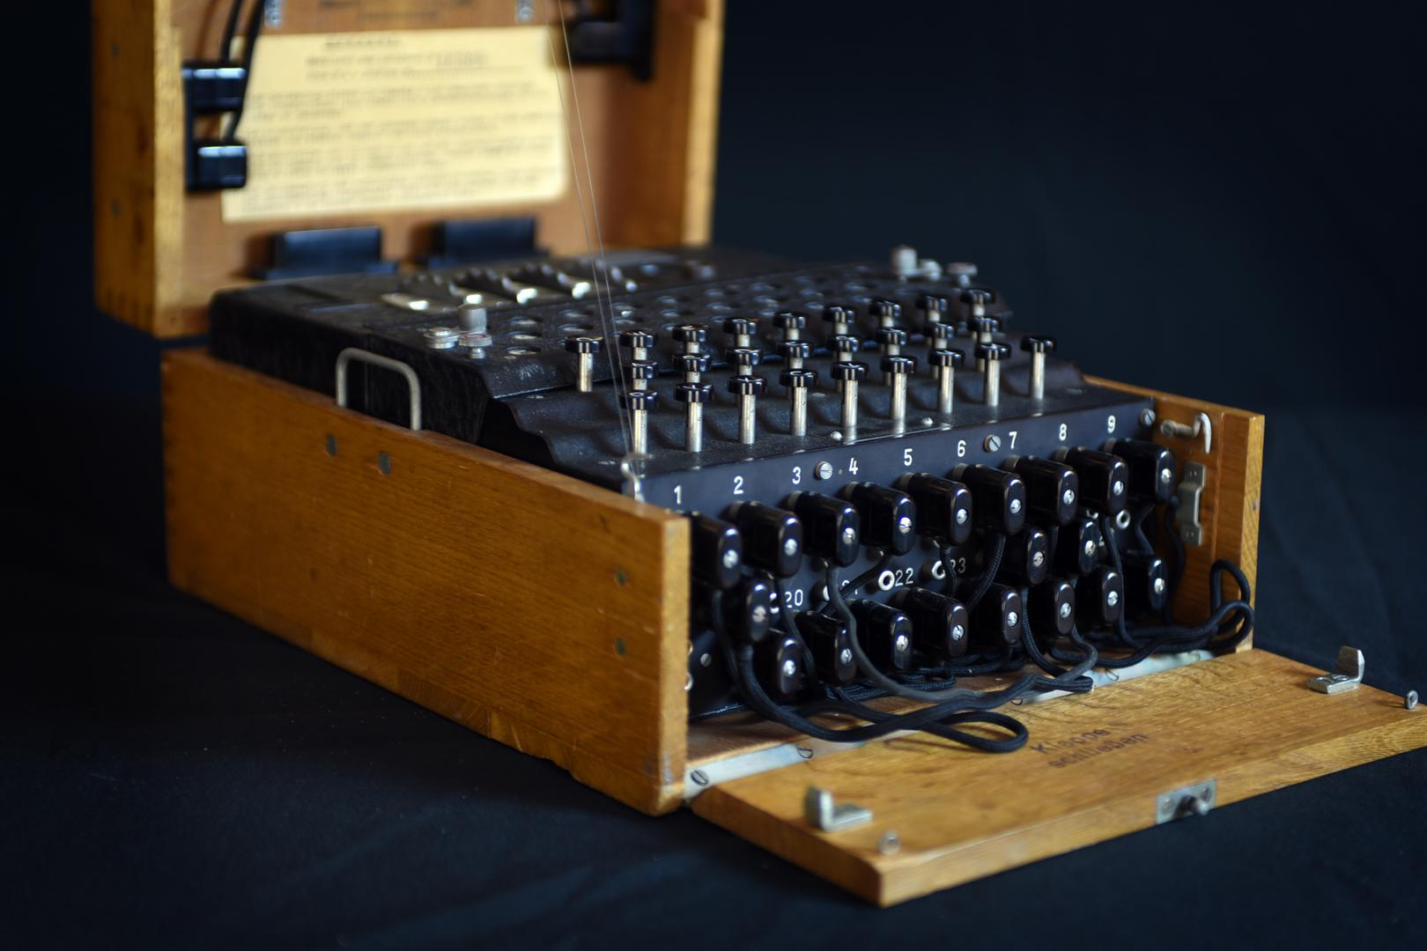
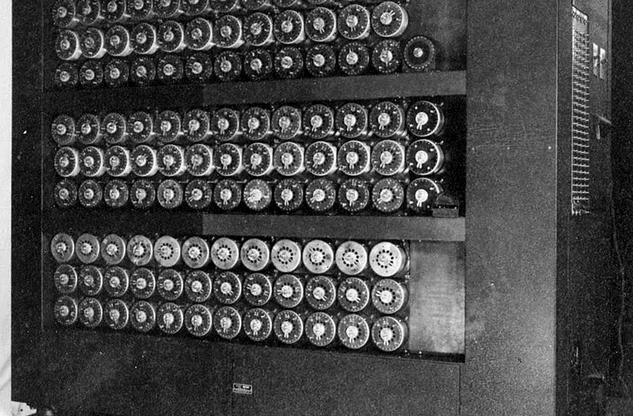
Turing's Codebreaking during World War II
Turing played an important role in breaking the Enigma code, a significant achievement during World War II that is estimated to have shortened the war and saved lives.
He development of the bombe machine. It was an electromechanical device, which capable of decoding Enigma-encrypted messages.

Slide 24
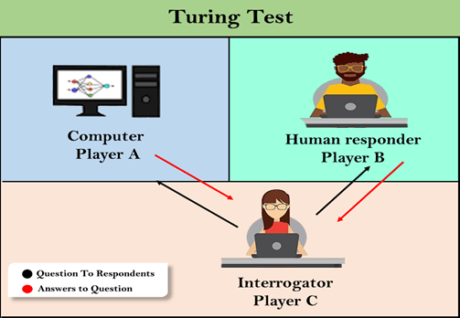
Turing Test
Human Judge Interaction - In the Turing Test, a human judge interacts with both a machine and a human, without knowing which is which.
Conversational Performance: - The machine's goal is to engage in a conversation that is indistinguishable from a human. If the judge cannot reliably differentiate between the machine and the human based on their responses, the machine is considered to have passed the Turing Test.
Criterion for Intelligence: The Turing Test serves as a benchmark for artificial intelligence, suggesting that a machine demonstrating human-like conversational abilities can be considered intelligent, at least in a linguistic context. The test does not assess other aspects of intelligence but focuses on the ability to emulate human-like dialogue effectively.

